Slide 1
RepairBud Car Servicing Application
Final Presentation

Slide 2
“Tell me and I forget, teach me and I may remember, involve me and I learn.”
—Benjamin Franklin

Slide 3
TABLE OF CONTENTS
01
02
Team
Project
03
04
Live Demo
CONCLUSIONS
Introduction of Team/Roles
Project Description and Scope of Project
Screenshots,
Detailed Demo Of Completed Project
Technologies Used.
Project Closure Report

Slide 4
The 01. Team

Slide 5
RepairBud Development Team
Artem Dryevov
Asim Patel
Patrick Parreno
Elham Salmanian
Project Co- Manager
Full-Stack Developer
Project Co- Manager
Full-Stack Developer
Project Co- Manager
Full-Stack Developer
Project Co- Manager
Full-Stack Developer

Slide 6
Our Teams Roles
01
02
03
Artem Dryevov
Asim Patel
Elham Salmanian
04
Patrick Parreno
QA Engineer
Lead Programmer
Cyber Secuirty
Database Management
QA Tester
Programmer
UX/UI Desgin
QA Tester
Programmer
User Interface Desgin
Validation/Security
Project Lead
Lead Programmer
UX/UI Design
Database Management

Slide 7
02.
Our Project ‘RepairBud’
Executive Summary, Project Vision, Goal

Slide 8
Repair Bud – Project Description
The main goal of our project is to focus on automotive shops that keep track of client information currently in paper base documentations and migrate them into an application that handles all storage and business process for them.
End Goal: Eliminate the need For Paper Base Documentation in automotive Repair Shops
Users will be able to
Store Customer Personal and Vehicle formation
Book and View Appointments
Customer Repair History

Slide 9



Personas
(A persona, in user-centered design and marketing is a fictional character created to represent a user type that might use a site, brand, or product in a similar way)
SERVICE ADVISOR
SERVICE CONCIERGE
SERVICE COORDINATOR
SERVICE MANAGER
Name:
Karlee Pontas
Gender:
Female
Age:
26
Occupation:
Senior Service
Advisor At Classic Honda
Name:
Sean Michaels
Gender:
Male
Age:
19
Occupation:
Full-Time Service
Concierge At Classic Honda
Name:
Alisa Puran
Gender:
Female
Age:
21
Occupation:
Full-Time Service
Coordinatoor At Classic Honda
Name:
Jonathan Benevides
Gender:
Male
Age:
38
Occupation:
Service Manager At Classic Honda

Slide 10
Scope
Book/View/Edit
Appointments
Create/View/Edit
Customer Profile
Create/View/Edit
Payment History
Users will have the ability to Book
A customers appointment
Users will have the ability to create,
And edit store a customers profile into the
System.
Users will have the ability to create
And modify payment Invoices that
Are inputted into the assignment
View Staff Members
Search/Sorting
Dashbaord/Media/Apps
Users will have the ability to view all staff members via a list. Managers
will have there own tab/list for themselves
Each list view will have a capable
Search function with auto fill functionalities. It will also allow you to store records based on the column.
The system will have a live data
Dashboard, you will also be able to upload images and chat/email within the application

Slide 11
Out-Scope...for now
Storing/Creating
Repair Orders
Printing Capabilities
Payments
We have decided to un-scope the create
And storage of repair orders. Although we
Will still be storing service history. Although
Not as detailed as Repair Orders.
We are not including payments in
Our software. Just manually inputted
Payment histories that staff will
Input.
Our software will not have have
printing capabilities for records
Stored in our application.

Slide 12
WHAT WE CREATED
Responsive UI
Full-Screen
Record Storage
UX/UI
Our site is responsive to any window on which you run it on
We have enabled full screen access to our site if wanted
Record Storage for fields needed for business processes
We created a site with well thought out user experience design

Slide 13
Live Demo .03

Slide 14
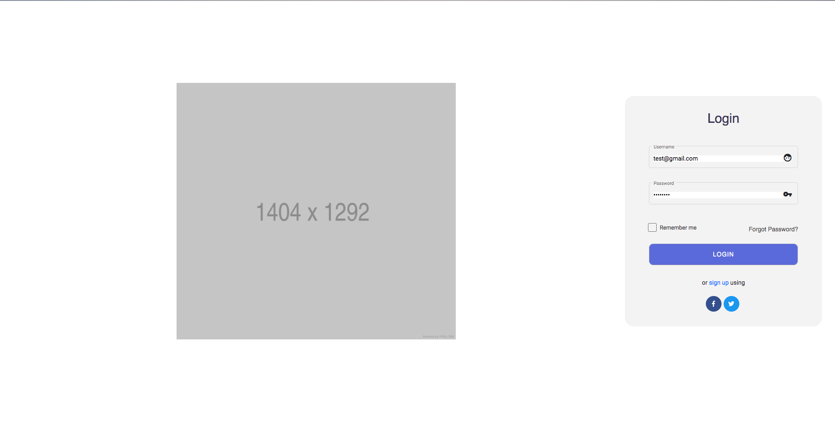
Screenshots From Application
Login

Slide 15
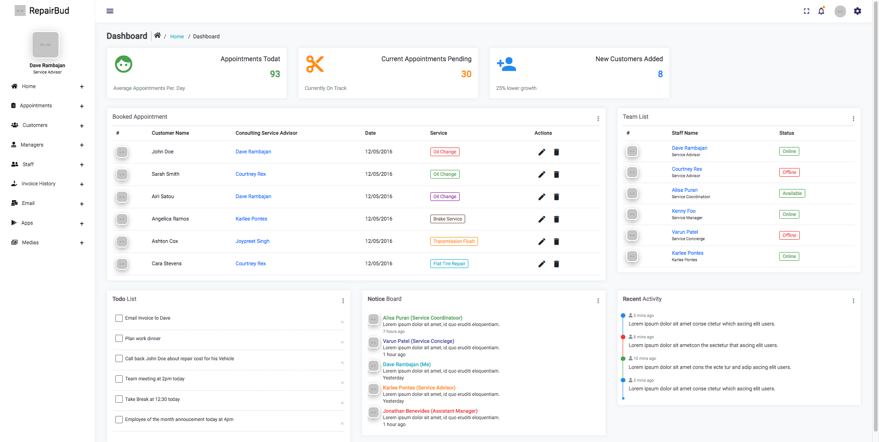
DashBoard

Slide 16
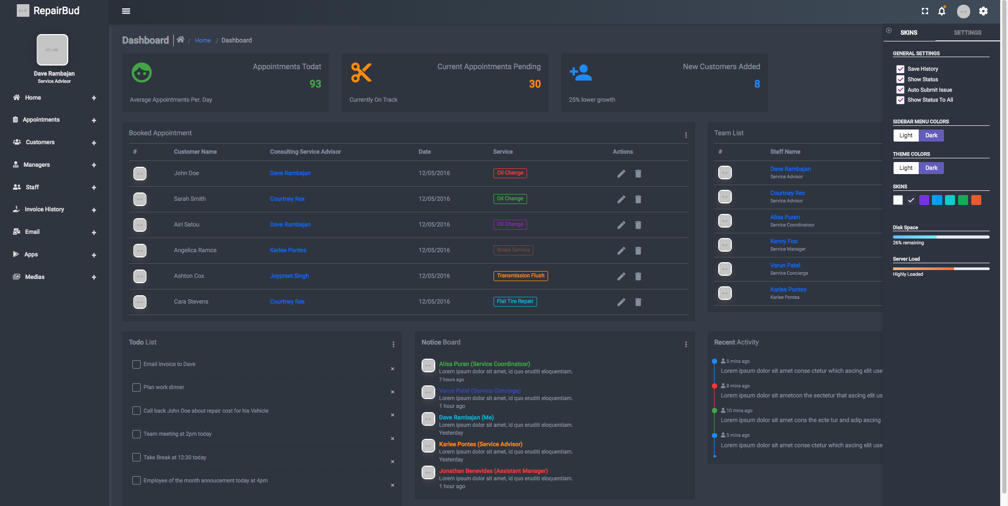
Theme Change

Slide 17
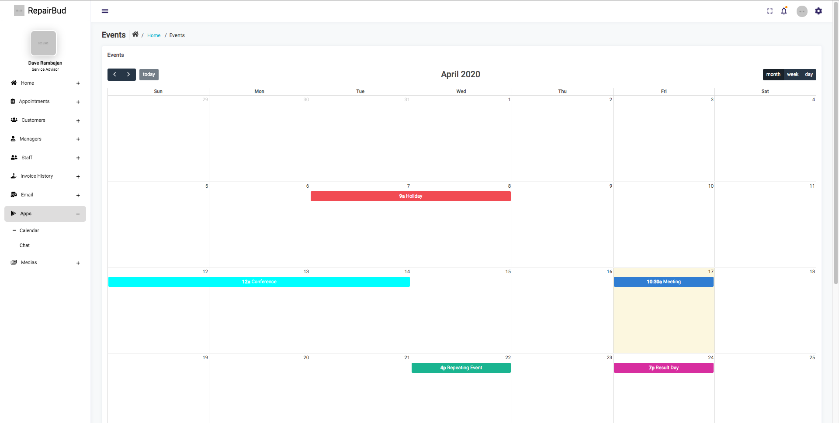
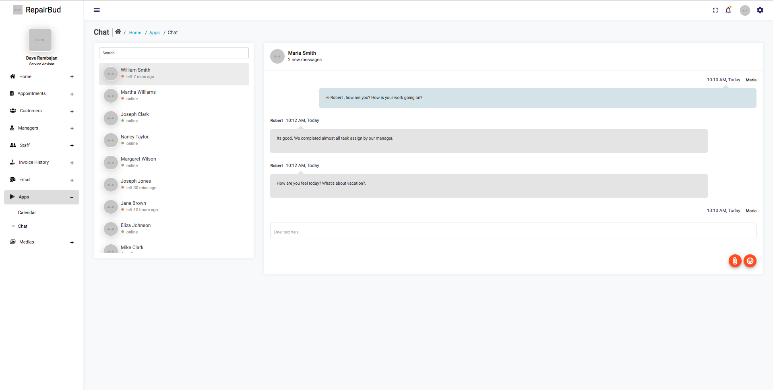
Chat/Calender

Slide 18
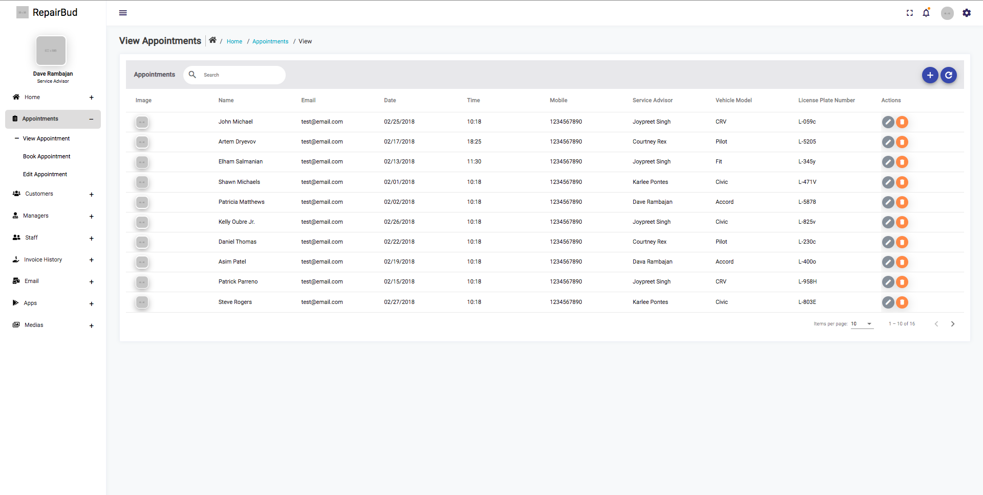
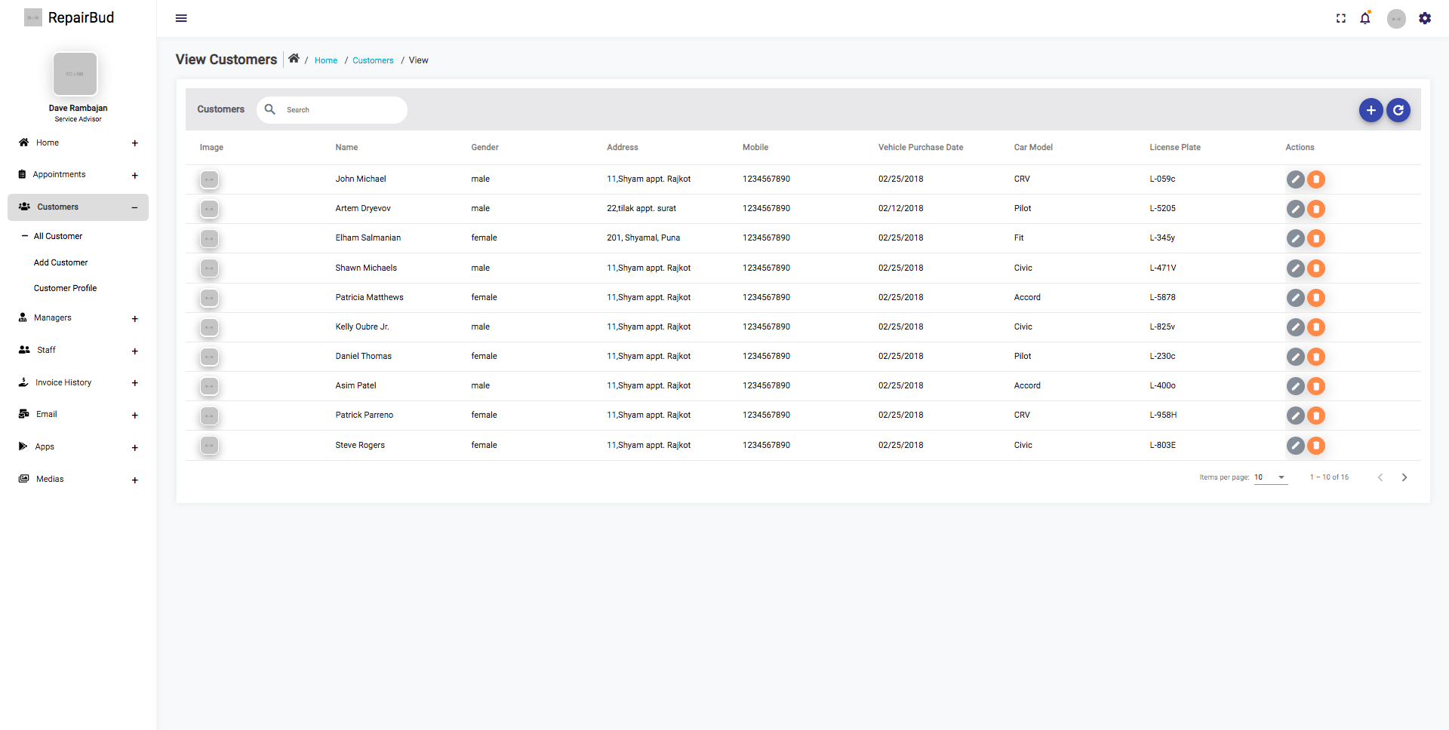
Table Views
(Appointment + Customer)

Slide 19
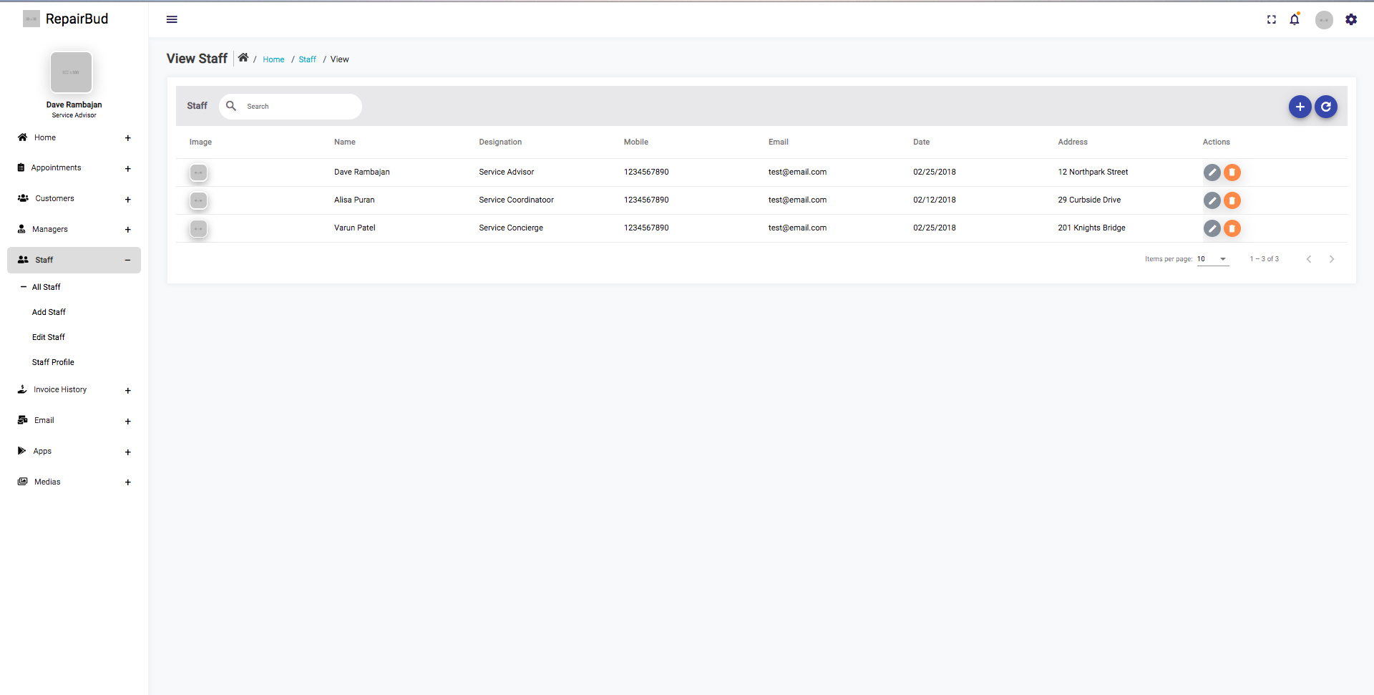
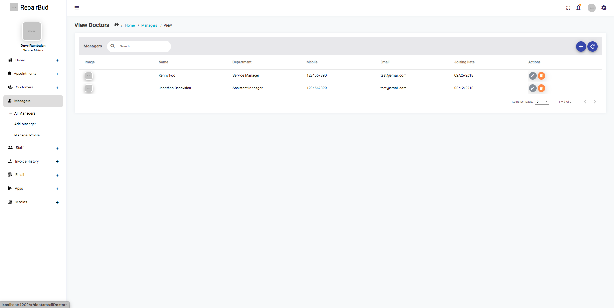
Table Views
(Staff + Managers)

Slide 20
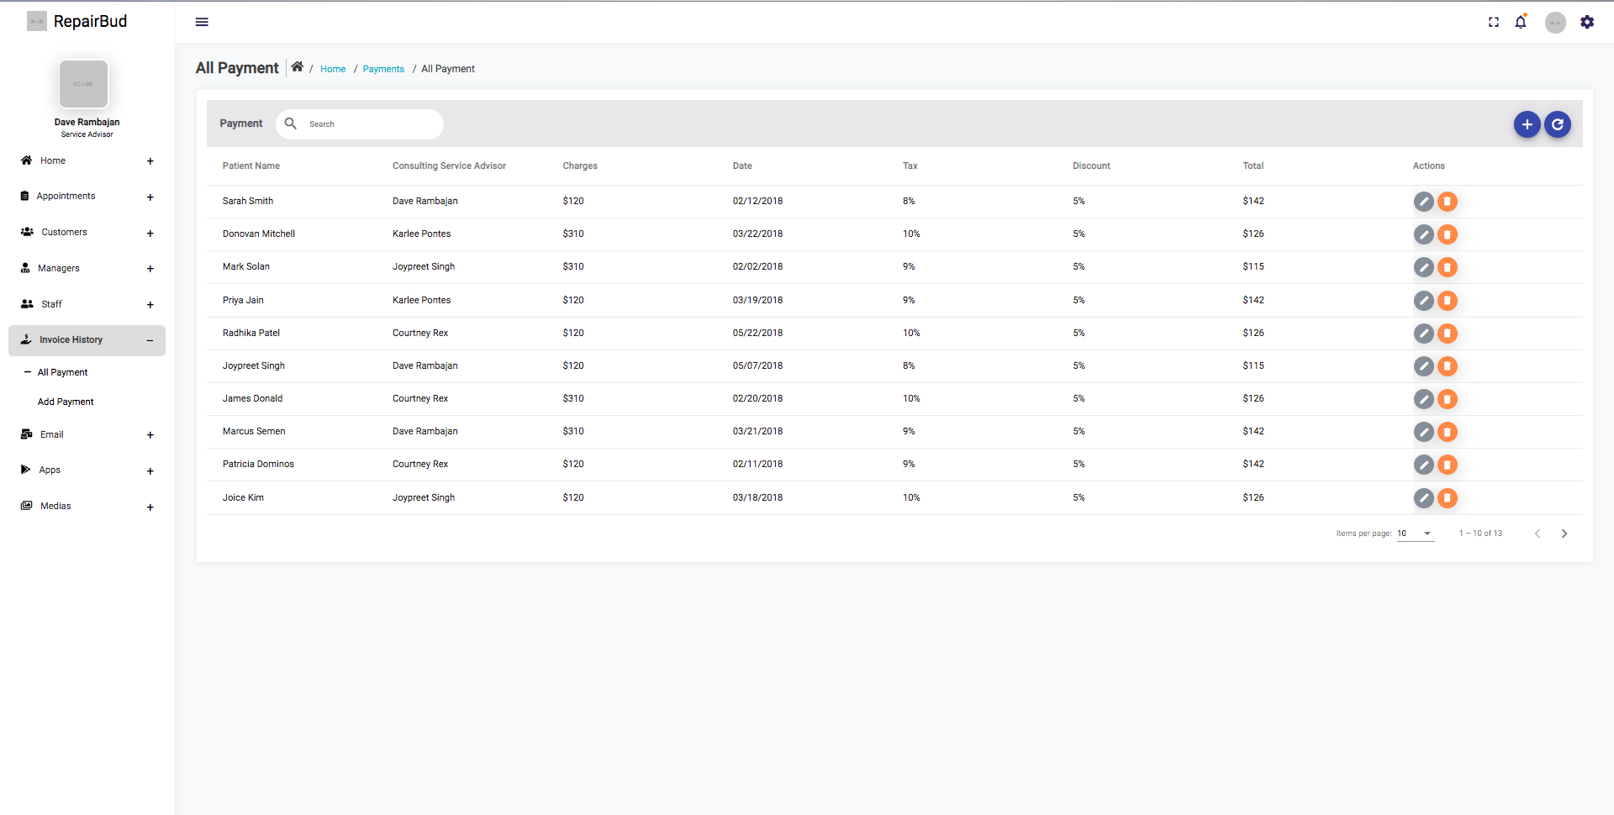
Table Views
(Invoice History)

Slide 21
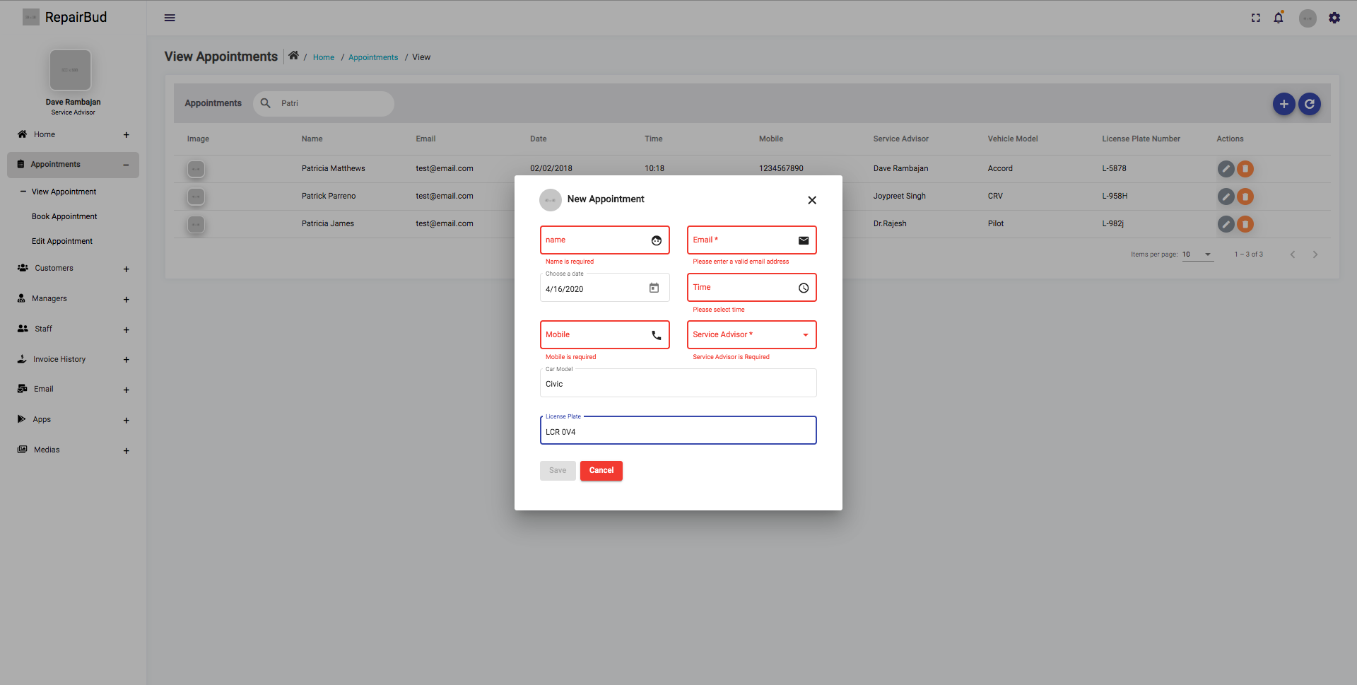
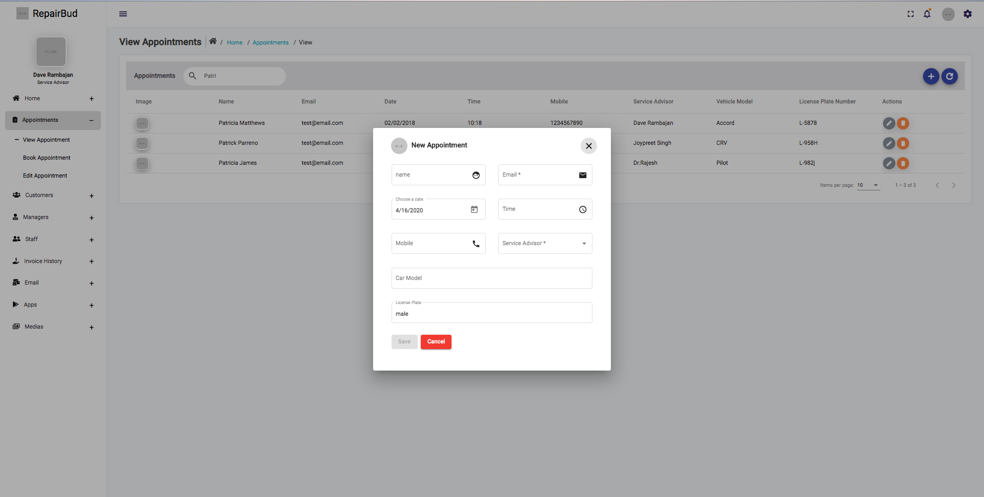
Table Views
Add + Validation
Note: All Validation and Forms are the
same in each table View, with there
respective fields

Slide 22
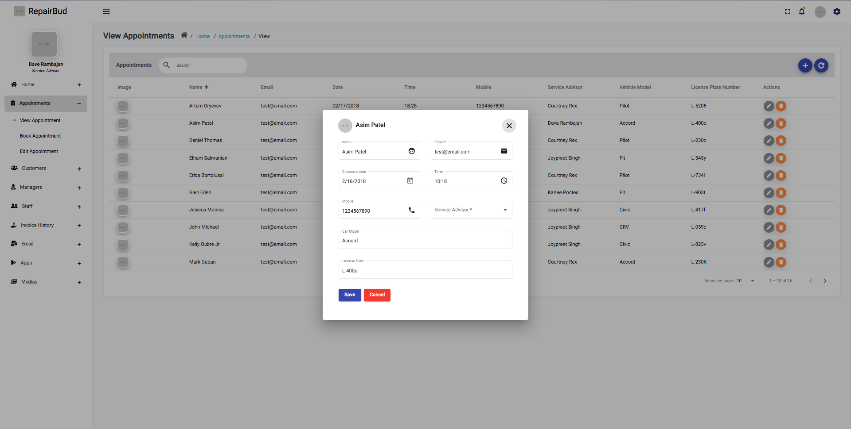
Table Views
Edit
Note: All editing is done in the same matter
In all table views, with there respective fields

Slide 23
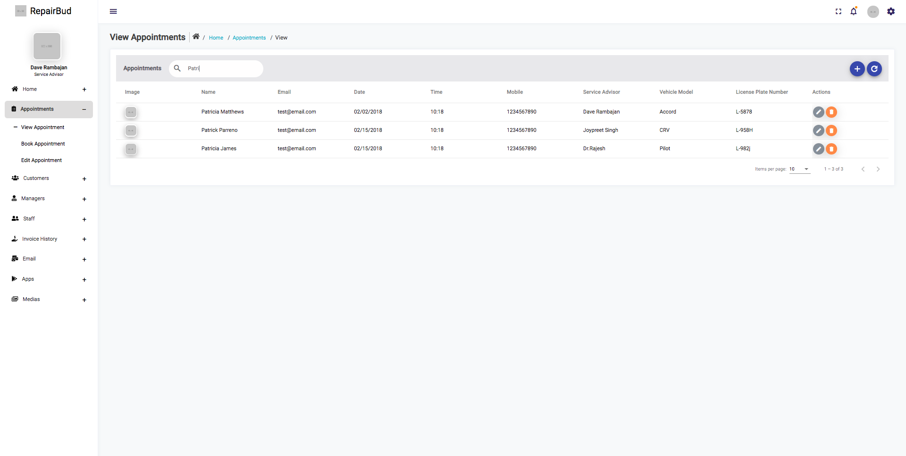

Table Views
Search + Sort
Note: All sorting and search have
the same capabilities in all table views

Slide 24
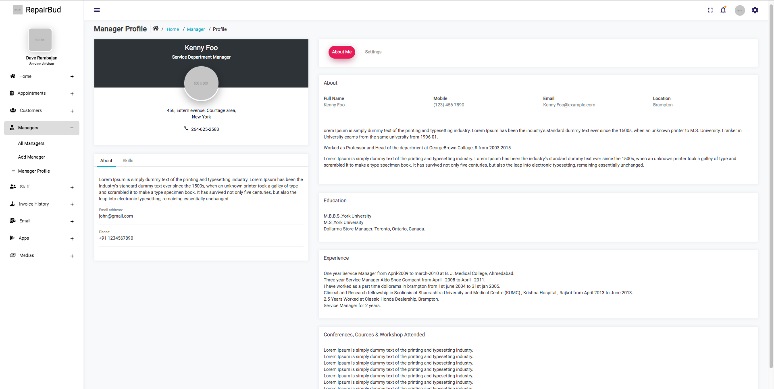
Profile Views
Manager

Slide 25
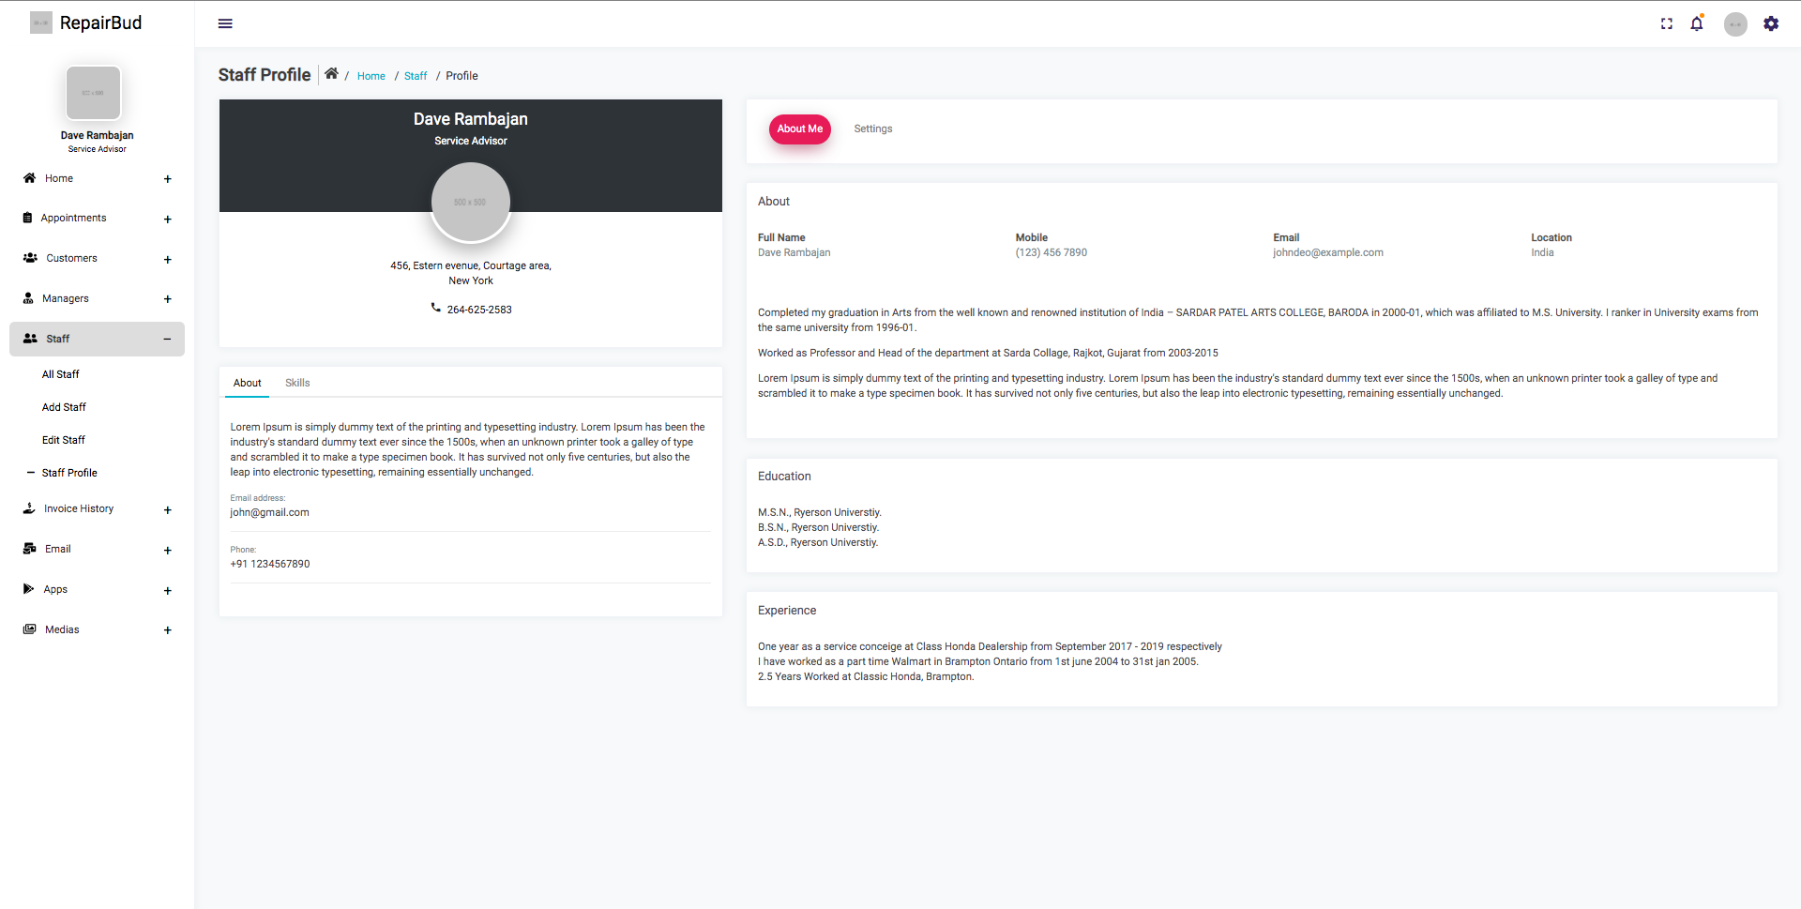
Profile Views
Staff

Slide 26
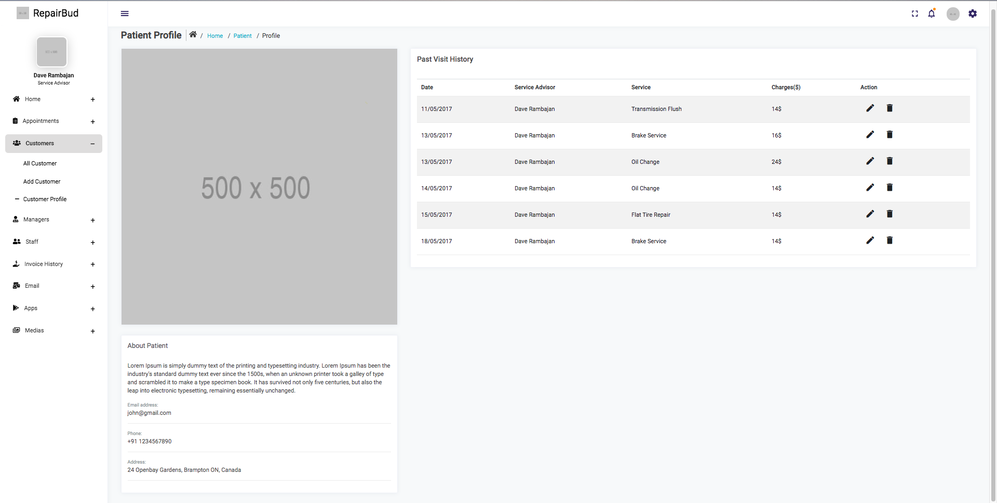
Profile Views
Customer

Slide 27
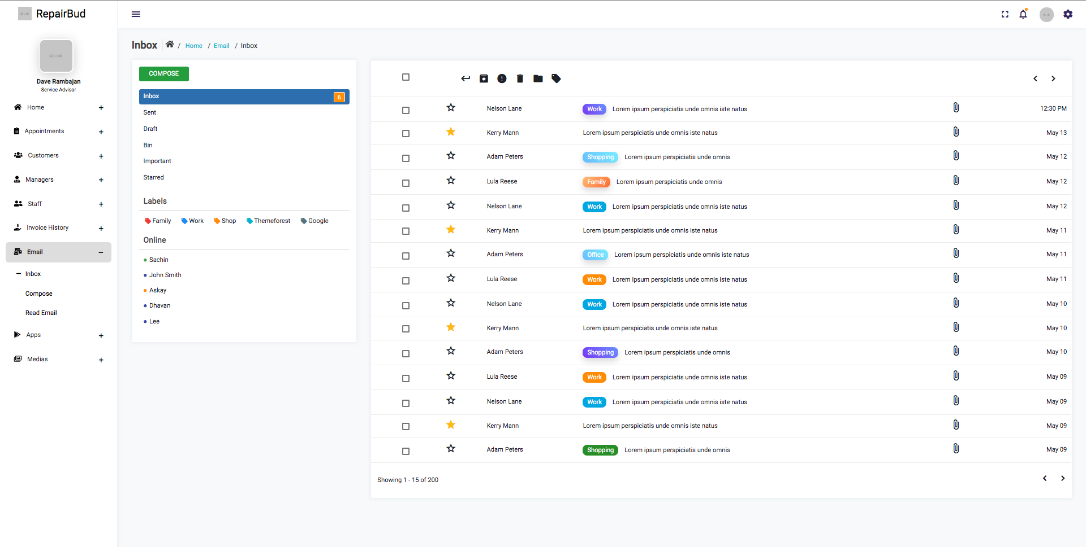
Email/Inbox

Slide 28
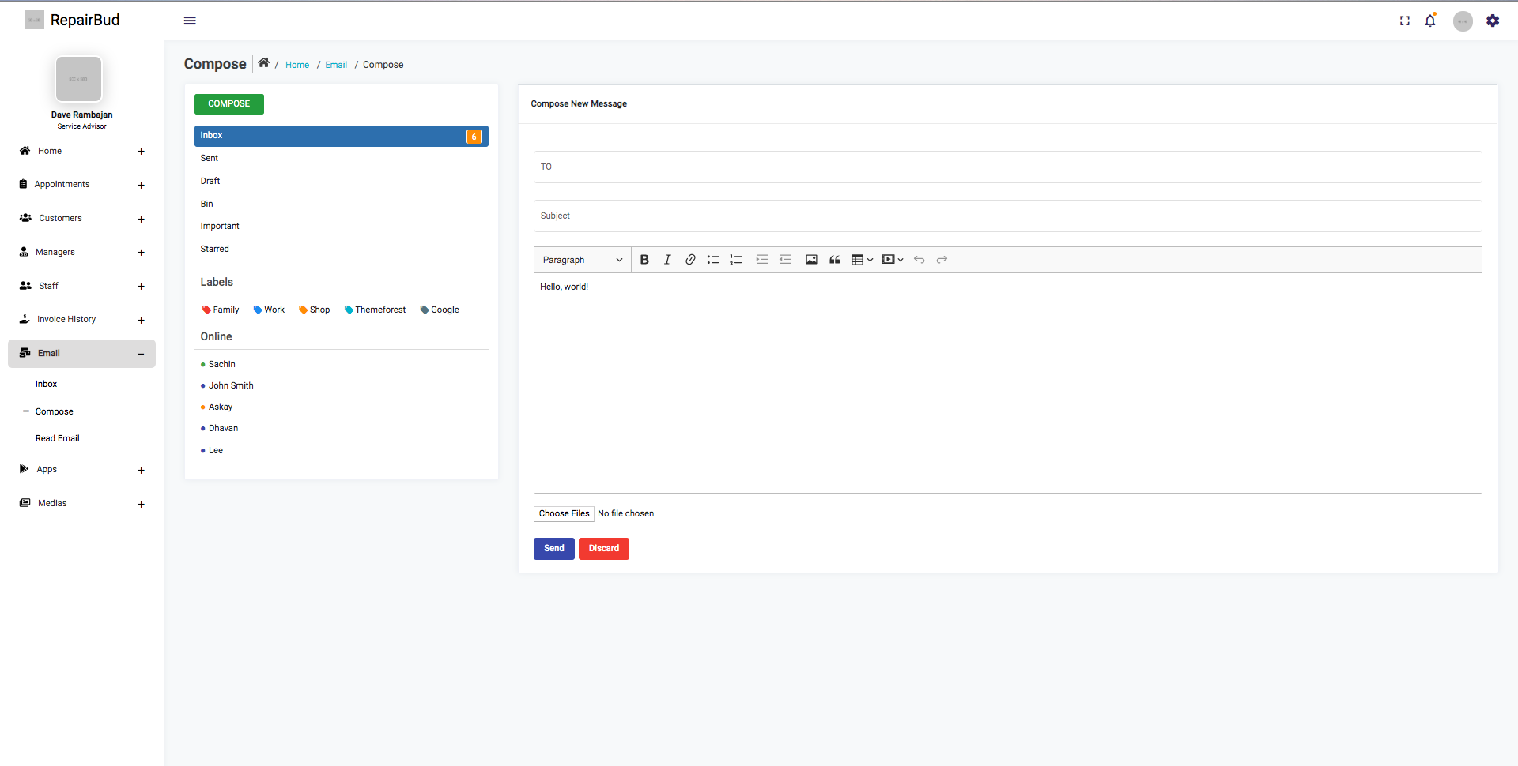
Email/Inbox
Compose

Slide 29
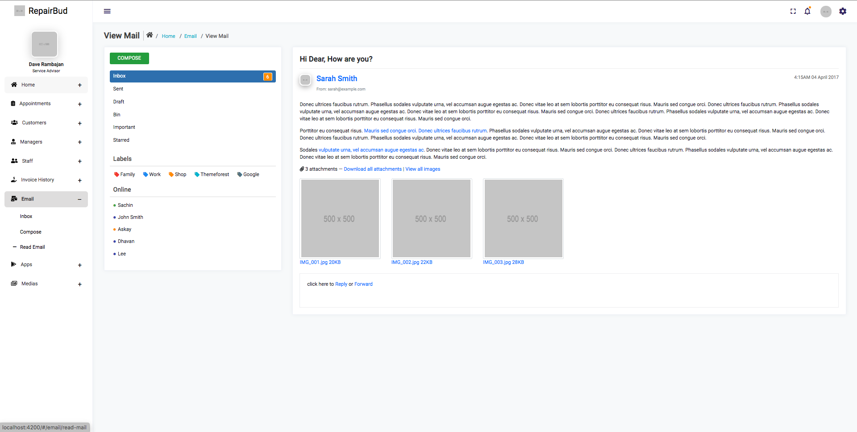
Email/Inbox
Read

Slide 30
Chat/Calender

Slide 31
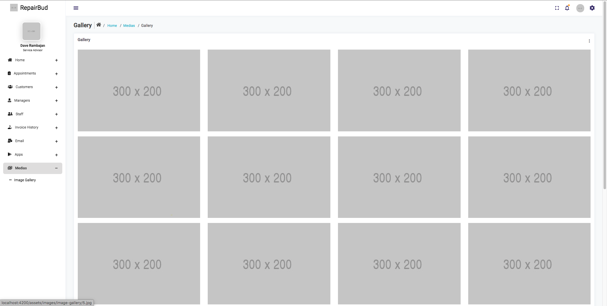
Image Gallery

Slide 32
Final Thoughts
O4.
Technologies Used/Project
Closure

Slide 33
Technology Used
MongoDB - Database
Express & Nodejs –
Server-Side API
Angular 8 – Front –End
NoSQL Database
Smaller Storage size for files
Easy syntax to work with angular and express
Great Engine for templating views need
Use of Angular Material for styling
Allows easy methods and functions to easily communicate with backend API
Great engine for displaying and render javascript in browser
Goes hand and hand with angular as they both have methods to communicate in both directions (Front-end to back-End
Easy syntax to read as it is a wrapper around vanilla JS

Slide 34
PROCESS/MILESTONES
2019 (Semester 1)
January 2020
March 2020
April 2020
01
02
03
04
Project Kickoff,
Gather System Requirements,
Documentation
Project Configuration,
Setup,
Branding,
Re-scoping
Development/
Implementation Phase,
Design Phase
Testing,
Final Presentation,
Project Close

Slide 35
Project Closure Report
Closure Activity
Confirmation
Project Value
Lessons Learned
As of right now our project is not
In the ideal form that we would like
It to be in
Rids business’ of the of the use
For paper documentation. Will help
Keep important business files safe.
Helps reduce waste.
Time Management, Focus,
Knowledge And Team Work are
Vital for any type of project.

Slide 36
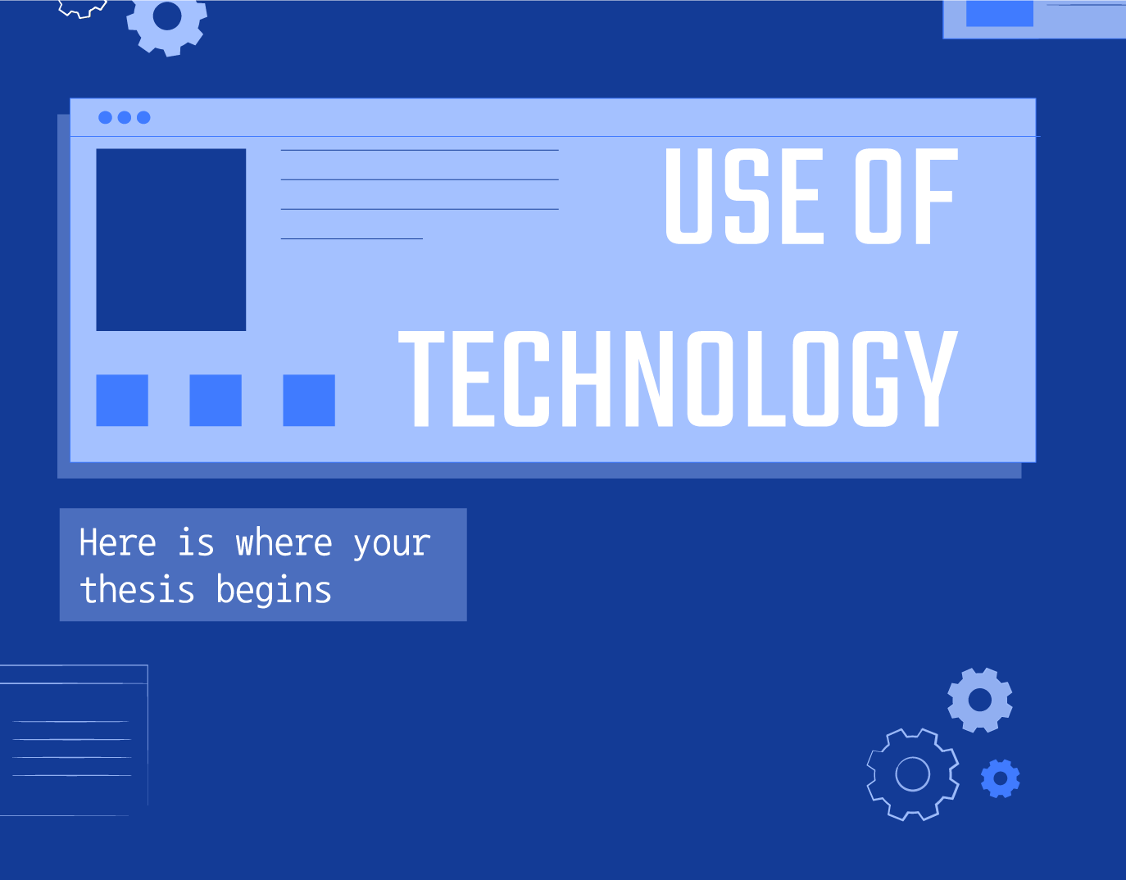
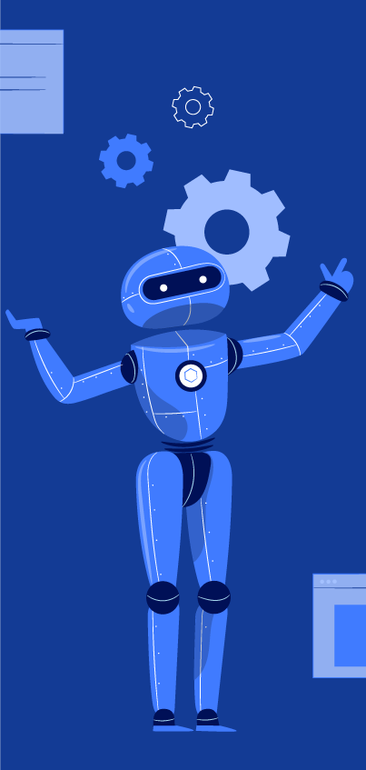
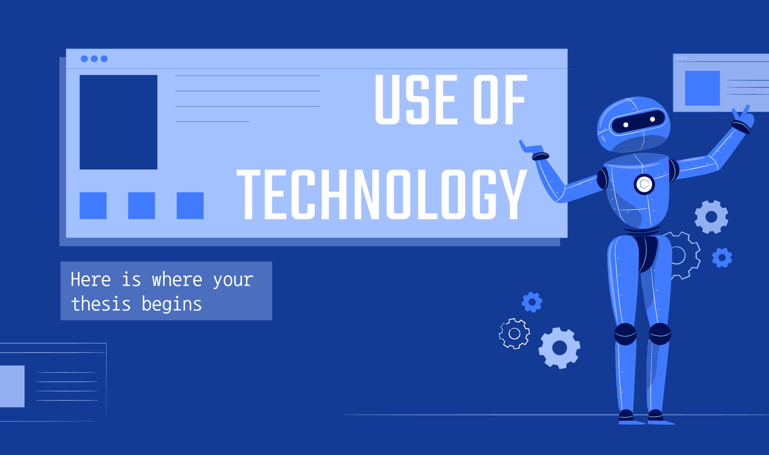
Future Goals
Get Application To Where We Want
Just because the end of the year signal the end of the project doesn’t mean we have to be satisfied with what we did
Keep On Growing as Programmers
This course taught us a lot. Some good and some bad, what we take away from this is that we need to constantly grow as programmers
Set-Up a Future Meeting
As we did not accomplish what we wanted to during this project, and knowing the ability we have as programmers. If it was not for
The hardships we encountered. We
Know we can complete this project

Slide 37
“Once you know what failure feels like, determination chases success.”
—Kobe Bryant

Slide 38
THANK YOU!
ANJANA
Presented By: Artem Dryevov, Asim Patel, Patrick Parreno & Elham Salmanian

